Slide 1
CSE 12 – Basic Data Structures and Object-Oriented Design Lecture 15
Greg Miranda & Paul Cao, Winter 2021
This lecture is being recorded

Slide 2
Announcements
Quiz 15 due Monday @ 8am
Survey 6 due Friday @ 11:59pm
PA5 due tonight @ 11:59pm

Slide 3
Topics
Map and HashTable
Questions on Lecture 15?

Slide 4
Questions on Lecture 15?

Slide 5
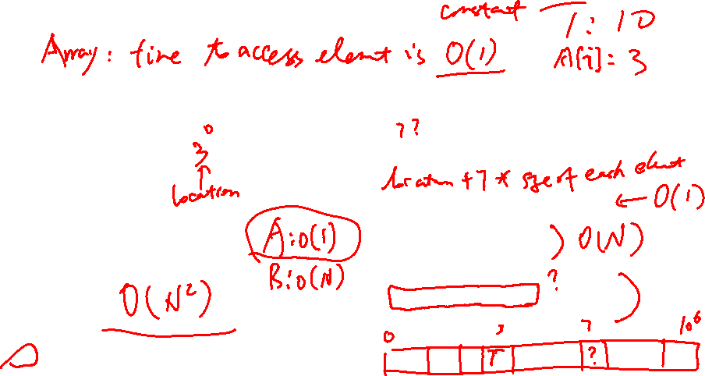
Hash table Motivation 1: Two sum problem
Consider the 2-sum problem: Given an unsorted array (A) of N integers between 0 and 1000,000, find all pairs of elements that sum to a given number T
A
Method 1:
for (i = 0; i<N; i++){
for (j =i+1;j<N; j++){
if ((A[i]+A[j])==T)
store (A[i], A[j]);
}
}
Method 2:
bool Hashtable[1000000]={false};
for (i = 0; i<N; i++){
Hashtable[A[i]]=true;
}
for (i = 0; i<N; i++){
if (Hashtable[T-A[i]]) == true)
store (A[i], T-A[i]);
}
Which approach is faster?
Method 1
Method 2
They are the same
Notes:
B

Slide 6
We have a student record system (i.e. ArrayList) and we will try to insert/delete/search for student
class Student{
int pid;//unique
double gpa;
public Student(int pid, double gpa){
this.pid = pid;
this.gpa = gpa;
}
public boolean equals(Object o){
//compare if two students are the same
if (o == null){
return false;
}
if (o instanceof Student){
Student s = (Student)o;
if (this.pid == s.pid){
return true;
}
}
return false;
}
}
public class StudentRecord{
ArrayList<Student> data;
int capacity;
int size;
// ctor etc
public boolean search(Student key){
for (int i = 0; i < size; i++){
if (data[i].equals(key)){
return true;
}
}
return false;
}
}
What will affect how fast I can search for this key?
It depends on the capacity
It depends on where the element is in the list
It depends on the size
A combination of some factors above

Slide 7
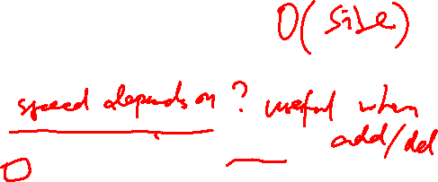
We have a student record system (i.e. ArrayList) and we will try to insert/delete/search for student
class Student{
int pid;//unique
double gpa;
public Student(int pid, double gpa){
this.pid = pid;
this.gpa = gpa;
}
public boolean equals(Object o){
//compare if two students are the same
if (o == null){
return false;
}
if (o instanceof Student){
Student s = (Student)o;
if (this.pid == s.pid){
return true;
}
}
return false;
}
}
public class StudentRecord{
ArrayList<Student> data;
int capacity;
int size;
// ctor etc
public boolean search(Student key){
for (int i = 0; i < size; i++){
if (data[i].equals(key)){
return true;
}
}
return false;
}
}
Is the search speed uniform?
The size of the ArrayList (i.e. capacity)
The number of elements already in the ArrayList (i.e. size)
Both A and B

Slide 8
An Improved ArrayList
public class StudentRecord{
private ArrayList<Student> data;
//ctor will make data very big (1M elements)
public boolean search(Student s){
position = s.magic();
if (data.at(position).equals(s)){
return true;
}
return false;
}
public boolean add(Student s) {
int position = s.magic();
if (data.get(position) == null) {
data.add(position, s);
return true;
}
return false;
}
…
}
What if every element of type E defined a method called “magic” that was guaranteed to return a unique int value between 0 and 9999999.

Slide 9
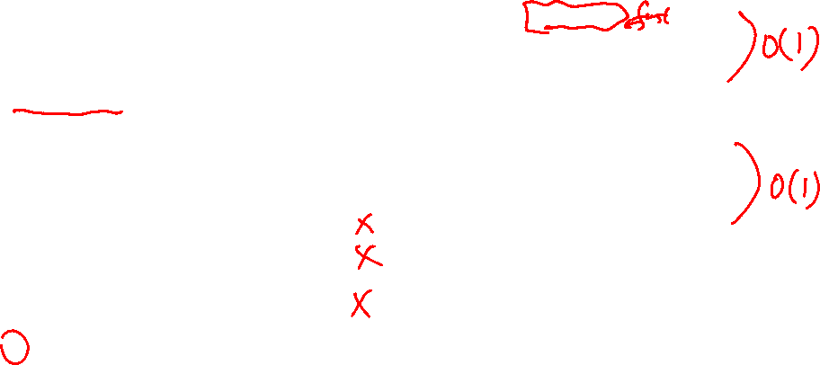
An Improved ArrayList
public class StudentRecord{
private ArrayList<Student> data;
//ctor will make data very big (1M elements)
public boolean search(Student s){
position = s.magic();
if (data.at(position).equals(s)){
return true;
}
return false;
}
public boolean add(Student s) {
int position = s.magic();
if (data.get(position) == null) {
data.add(position, s);
return true;
}
return false;
}
…
}
What if every element of type E defined a method called “magic” that was guaranteed to return a unique int value between 0 and 9999999.
If this could be done, which of the following is true of this approach?
It might allow duplicate elements to be inserted.
If there are a lot of elements in the data, it might become slow to check if an element is in the set.
If there are a lot of elements in the data, it might become slow to add a new element to the data.
B&C only
None of the above
Notes:
E

Slide 10

An Improved ArrayList
public class StudentRecord{
private ArrayList<Student> data;
//ctor will make data very big (1M elements)
public boolean search(Student s){
position = s.magic();
if (data.at(position).equals(s)){
return true;
}
return false;
}
public boolean add(Student s) {
int position = s.magic();
if (data.get(position) == null) {
data.add(position, s);
return true;
}
return false;
}
…
}
What if every element of type E defined a method called “magic” that was guaranteed to return a unique int value between 0 and 9999999.
Why is this not possible? What is the problem here?
Notes:
E

Slide 11
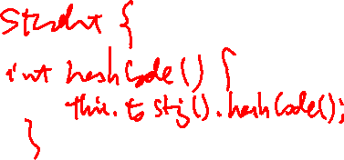
An Improved ArrayList
public class StudentRecord{
private ArrayList<Student> data;
//ctor will make data very big (1M elements)
public boolean search(Student s){
position = s.hashCode();
if (data.at(position).equals(s)){
return true;
}
return false;
}
public boolean add(Student s) {
int position = s.hashCode();
if (data.get(position) == null) {
data.add(position, s);
return true;
}
return false;
}
…
}
What if every element of type E defined a method called “magic” that was guaranteed to return a unique int value between 0 and 9999999.
But Java (almost) has this method!
Notes:
E

Slide 12
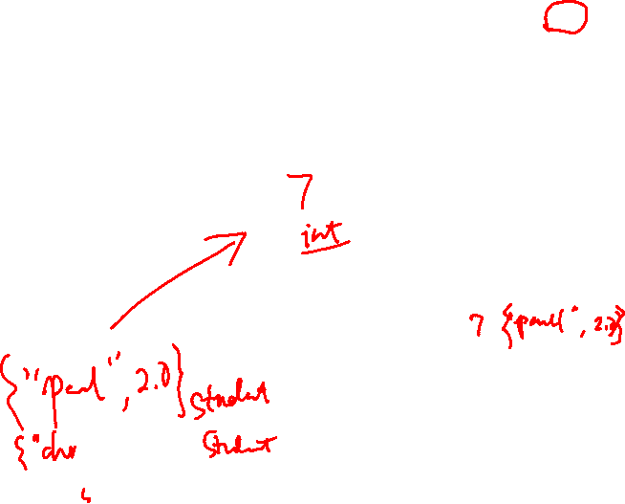
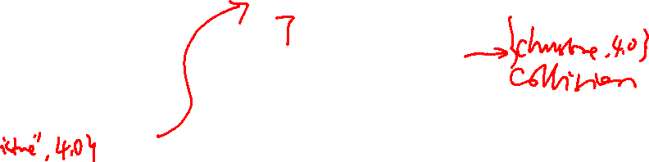
Hashing
Hash table (array)
index
data
Let’s modify our array-based look up table
Need a hash-function h(x): takes in a key, returns an index in the array
gold standard: random hash function
In general, no null value is allowed in table
Table size is fixed and in general large
(might be collisions)
HC
Key
Hash Code (HC)
Size is proportional to # of keys (not value of keys)
Hash function
(must be fast)
Key

Slide 13
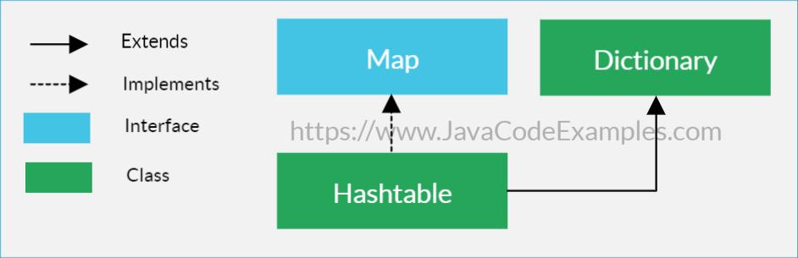
Hashtable
java.util.Hashtable
Implementation of the Map interface extension of Dictionary abstract class
Does not guarantee the order of things
Mean the elements may not be returned in the same order in which they were inserted into the hashtable

Slide 14

Map Interface
https://docs.oracle.com/javase/10/docs/api/java/util/Map.html
A map contains values on the basis of key, i.e. key and value pair.
Each key and value pair is known as an entry.
Contains unique keys
Useful when you have to search, update or delete elements on the basis of a key
Does not allow duplicate keys, but you can have duplicate values.

Slide 15
Dictionary Abstract Class
Key/value storage repository and operates like a Map
Given key and value, you can store the value in a dictionary object.
Once value stored, you can retrieve it by using its key.

Slide 16
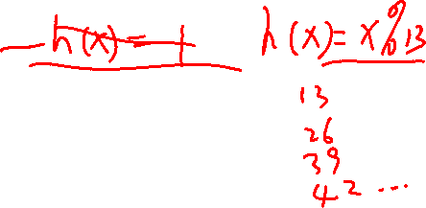
What is a Hash Table?
A Hash Table is a data structure.
Each list known as a bucket. The position of the bucket is identified by calling the hashcode() method. A hashtable contains values based on the key.
Contains unique elements
Does not allow null key or value
Offers fast insertion and searching
They are limited in size because they are based on arrays
Can be resized, but it should be avoided

Slide 17
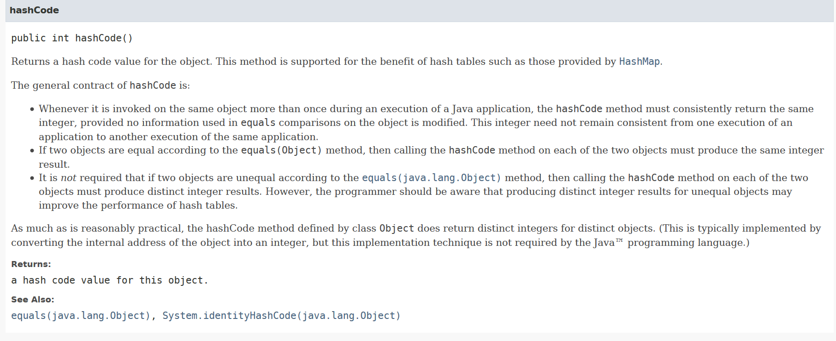
What if every element of type E defined a method called "getLocationInArray()" that was guaranteed to return a unique int value between 0 and 999.
Generates a number that can be used by a hash function (or simply as the hash value itself)

Slide 18
In general, what is the difference between the value returned by hashCode() and the index location where the item ends up in a particular hash table?
Nothing. The value returned by hashCode can be used directly as the index for the item in any hash table
The value returned by hashCode might be larger than the size of the hash table
The hashCode function might return the same value for two different objects, and indexes in hash tables must always be unique for different objects
The hashCode function might return different values for two objects that are considered equal (and for hash tables, two values that are considered equal must have the same hashcode/index value)
But Java (almost) has this method!

Slide 19
Finite “universe” of objects to store
Sometimes there may exist only a finite universe of possible keys/ elements to insert into a hash table.
Sometimes this finite set of keys is small enough that we can allocate an array big enough to give every possible key its own slot.
In this case, we can make the “search” process for a particular key trivial
We simply “jump” to the unique array index assigned to that key.
This takes only O(1) time in the worst-case.

Slide 20
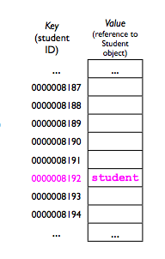
Finite “universe” of objects to store
For example, if we have a UCSD student database and each student has an id, we could allocate an array 4 billion elements long.
We could define the hashCode() function of a student object to return the student's id, then use that value directly in the array.
When adding a student, we simply insert an entry at his/her unique location.
(IDs are guaranteed to be unique).

Slide 21
Hash functions
A hash function maps an object or key to a position in an array (the hash table). What properties are required and/or desired from a good hash function?

Slide 22
Hash function
To be useful, a hash function must be fast
Its performance should not depend on the particular key.
Runs in "constant time" (more on this later…)
A hash function must also be deterministic:
Given the same value, it must always return the same array index. (Otherwise, how would we find something we stored earlier?)
A “good” hash function should also be uniform:
Each “slot” i in the array should be equally likely to be chosen as any other slot j.

Slide 23
Is it a good hash function?
int hashFucntion (int studentID){
return M/2;
} //M is a size of a HT
A: Yes,
B: No, it is not fast
C: No, it is not deterministic
D: No, it is not uniform
Make it better…
How do you write a good hash function for objects?
Notes:
D, not uniform

Slide 24
Hash Tables & Hash Functions
Key values are assigned to elements in a Hash Table using a Hash Function
A Hash Function helps calculate the index an item should go in
Index must be small enough for the arrays size
Don’t overwrite other data in the Hash Table
A Hash Functions job is to store values in an array with a limited size
It does it in a way that the array doesn’t need to be searched through to find it
Enter values in any order
Be able to find them using a calculation instead of searching through the array

Slide 25
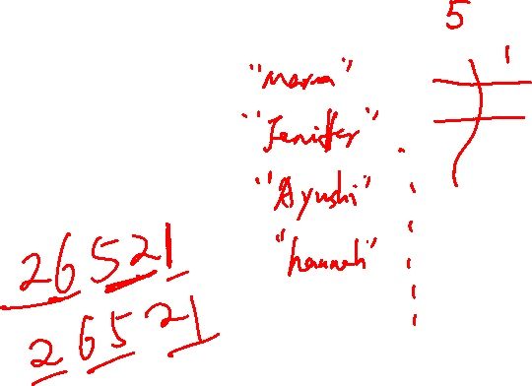
Hash Table – draw the picture (Separate Chaining)
int getIndex(String k) {
return k.length;
}
# of buckets – 6
(i.e. the size of the array)
set(“Smith”, 1);
set(“Johnson”, 2);
set(“Williams”, 3);
set(“Brown”, 4);
set(“Jones”, 5);
set(“Garcia”, 6);
set(“Miller”, 7);
set(“Davis”, 8);
set(“Rodriguez”, 9);
set(“Martinez”, 10);

